Slide 2
" In The Name of Allah, The Most Beneficent, The Most Merciful" Common Mistakes Practiced by Halal Certification Bodies How Important is Halal to You? By: Dr. Hani M. Al-Mazeedi

Slide 3
The consumer has the right to know
من حق المستهلك أن يعرف
And deliberately consumers are made not to know
ويتم عمداً جعل المستهلك لا يعرف

Slide 4
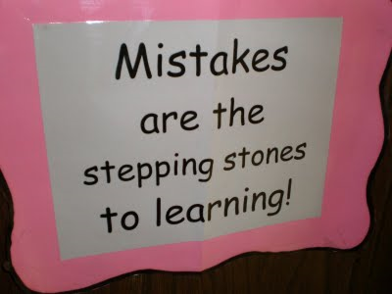
Scope
This presentation shed the light on common mistakes practiced by Halal certification bodies, HCB; as well as drawbacks of Halal organizations.
This presentation also has the aim of ımrovıng the performances to provıde better Halal certification services with the highest level of Halal products.

Slide 5
Outline
Introduction
Common mistakes practiced by Halal certification bodies
Conclusion
Recommendations

Slide 6
Introduction
With the increasing Muslim population, there has been a global increase in the demand for Halal services and Halal products (food and non-food)*.
*Darhim Dali Hashim: Introduction to The Global Halal Industry and its Services, Halal Industry and its Services Conference
24-26 January 2011, State of Kuwait. http://www.islam.gov.kw/site/ads/Gulf1_Halal/First_day/day/1_%20Darhim%20Dali%20Hashim.pdf, And 9th MEETING OF THE OIC STANDARDISATION EXPERTS GROUP, 16-18 April, 2008 in Ankara, Turkey

Slide 7
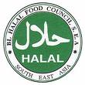
Muslim consumers look for Halal Logo upon product before purchase for consumption or for use. This warrants يضمن, in some cases, that the Halal service or product to be genıunly Halal*.
*Darhim Dali Hashim: Introduction to The Global Halal Industry and its Services, Halal Industry and its Services Conference
24-26 January 2011, State of Kuwait. http://www.islam.gov.kw/site/ads/Gulf1_Halal/First_day/day/1_%20Darhim%20Dali%20Hashim.pdf, And 9th MEETING OF THE OIC STANDARDISATION EXPERTS GROUP, 16-18 April, 2008 in Ankara, Turkey

Slide 8
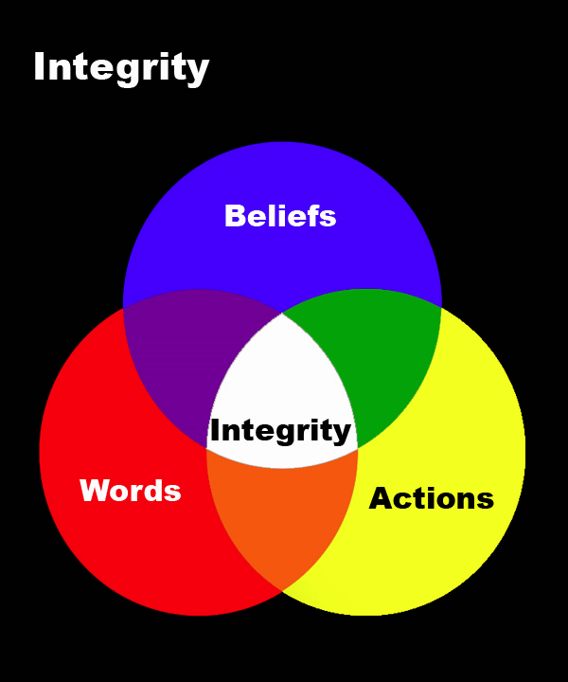
However, the most important aspect of Halal certification services is the integrity of its Halal supply chain*.
And ın most cases, at present, the Halal ıntegrıty of these chaıns can not be guranteed.
*Darhim Dali Hashim: Introduction to The Global Halal Industry and its Services, Halal Industry and its Services Conference
24-26 January 2011, State of Kuwait. http://www.islam.gov.kw/site/ads/Gulf1_Halal/First_day/day/1_%20Darhim%20Dali%20Hashim.pdf, And 9th MEETING OF THE OIC STANDARDISATION EXPERTS GROUP, 16-18 April, 2008 in Ankara, Turkey

Slide 9
The information included in this presentation were obtained from the views of some international HCBs, and Halal institutes of Malaysia.
In addition, and being in Halal since 1980, I have added some of my personal notes on HCBs and Halal accreditation organizations.

Slide 10
These are some of the common mistakes practiced by Halal certification bodies:
Lack of competent Halal certification system.
Not following Halal procedures.
Lack of transparency.
Lack of Islamic behaviors.
Lack of commitment from the management.
Lack of Halal raw materials supply.<
Lack of Halal technical training.

Slide 11
1
Lack of competent Halal certification system
1-1 Many Halal certification bodies (HCB) do not comply with governmental approved Halal standards or the food safety standard ISO 22000.
Examples:
STANDARDIZATION ORGANIZATION FOR G.C.C (GSO)
GSO 993 / 1998
اشتراطات ذبح الحيوان
طبقا لأحكام الشريعة الإسلامية
ANIMAL SLAUGHTERING REQUIREMENTS
ACCORDING TO ISLAMIC LAWئ
GSO Halal Standard, and
Food Safety Management Standards: ISO22000

Slide 12
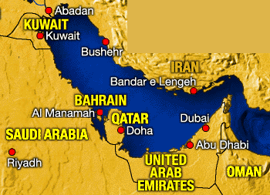
GSO Halal standards cover 6 main Gulf countries: Saudi Arabia, Kuwait, United Arab Emirates, Qatar, Bahrain, Oman, and lately Yemen was accepted as one of the GSO members.

Slide 13
What is in GSO Halal Standard that is not followed?
STANDARDIZATION ORGANIZATION FOR G.C.C (GSO)
GSO 993 / 1998
اشتراطات ذبح الحيوان
طبقا لأحكام الشريعة الإسلامية
ANIMAL SLAUGHTERING REQUIREMENTS
ACCORDING TO ISLAMIC LAWئ
3.2.6 Beating on head or similar action, such as using of bolt shot pistol or non penetrative percussion or stunning by carbon dioxide is not permitted.
3.2.7 Electrical stunning is not allowed in case of birds.
How many HCB observe these rules?
Answer: no one.

Slide 14
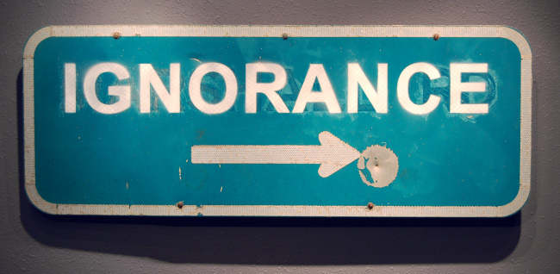
1-2 Many HCB lack of commitment to consumers.
This is due to ignorance in the professional skills of Halal requirements.
And for this reason practically many HCB has been disqualified to carry out the duties of Halal services by experts in Halal on religious ground.

Slide 15
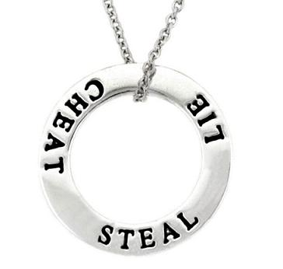
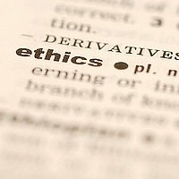
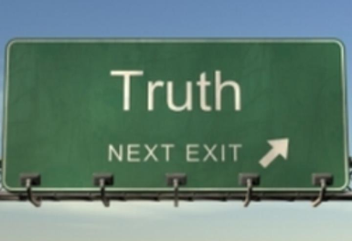
1-3 Many HCB are non-ethical.
Due to economical and animal welfare conflicts with non-Muslim owners of slaughterhouses or plants, in many cases, HCB finds themselves forced to accept non-Halal laws, and this is done without the knowledge of Muslim consumers.

Slide 16
1-4 Most HCB do not have Scientific and Sharieah committees.
The two committees are necessary to:
1) work hand in hand to investigate new technologies, to solve emerging issues linked with certain technologies, to understand what actually happened during processing and the true nature of raw materials, and
2) to give guidance on how to switch Haram productions lines to Halal lines i.e. how to apply acceptable cleansing on certain lines.

Slide 17
1-5 Most HCB internationally not recognized.
How many HCB are internationally recognized? Only few

Slide 18
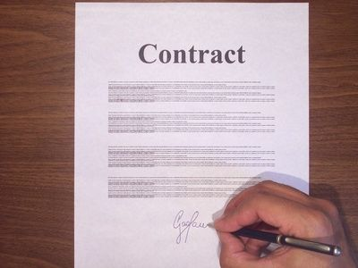
1-6 Most HCB do not have international contracts.
How many HCB have international Halal contracts? Traces

Slide 19
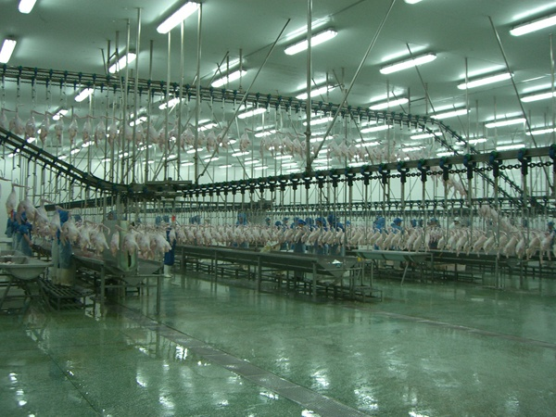
1-7 Some HCB do not have their own Halal manual standard, e.g. written slaughtering requirements.

Slide 20
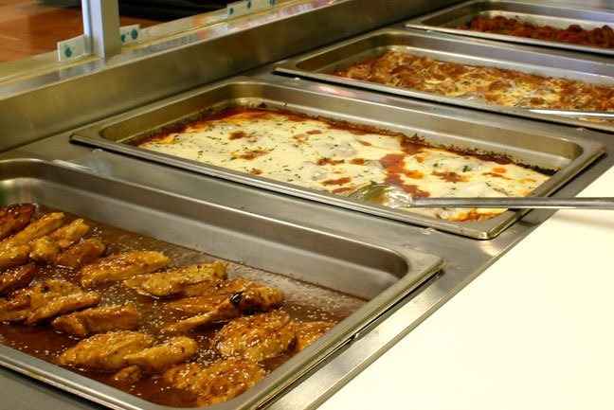
1-8 Many Halal meat certifying bodies are ignorant with the Halal requirements of processed food.
In the west, HCB that certify restaurants that sell meals containing their own Halal certified meat they do not pay attention to other food ingredients contained these meals (e.g. cheeses in burgers, bread, and sauces, etc.).

Slide 21
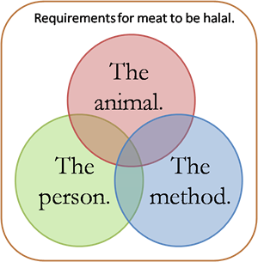
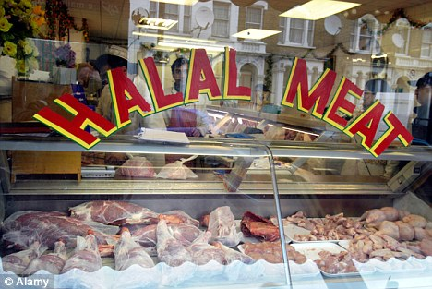
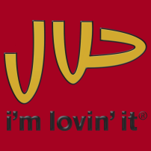
1-9 HCB’s activities are not regulated by any Halal laws.
Are all Halal certified products/services or meat comply with Halal requirements?
Halal laboratory analyses must be performed by Muslims.

Slide 22
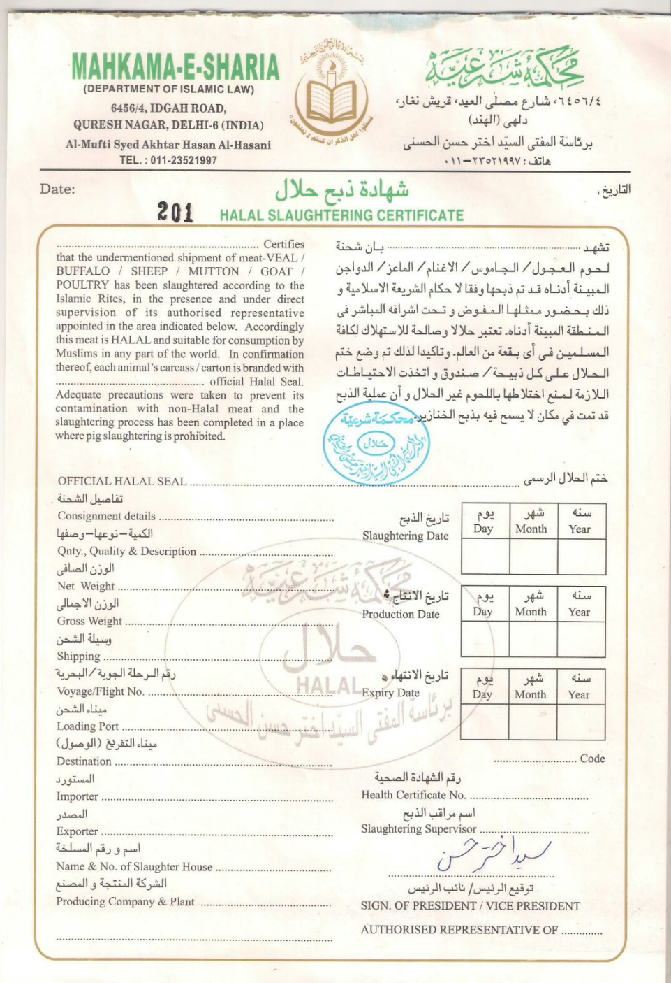
Some HCB sign and seal a blank Halal certificate!!
How many Halal consignments have similar Halal certificates?

Slide 23
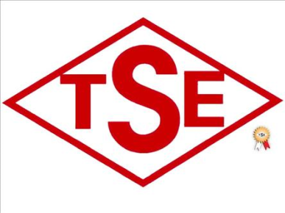
1-10 despite of the meetings and efforts in various countries, a universal Halal certification system has not evolved yet due to lack of concertedمتضافرة efforts.
Each Halal organization is trying to protect its own territory. This has affected the infrastructure quality of the Halal service.

Slide 24
1-11 Many HCB has no interest in formulating a competent well trained Halal team.
Sharieah knowledge
International Standards
knowledge
Scientific knowledge
Training
Competent Halal Team
The Halal team of HCB lack training not only in sharieah and scientific knowledge but also in the newly introduced Food Safety Management Systems such as ISO22000.

Slide 25
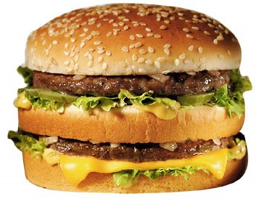
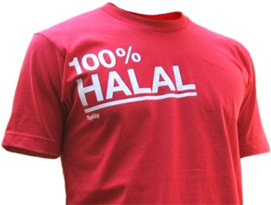
1-12 Many HCB do not have sufficient diverse professionals with the relevant competency and skills in Halal.
The Halal industry need to have Halal professionals in every area to serve any targeted Halal issue.

Slide 26
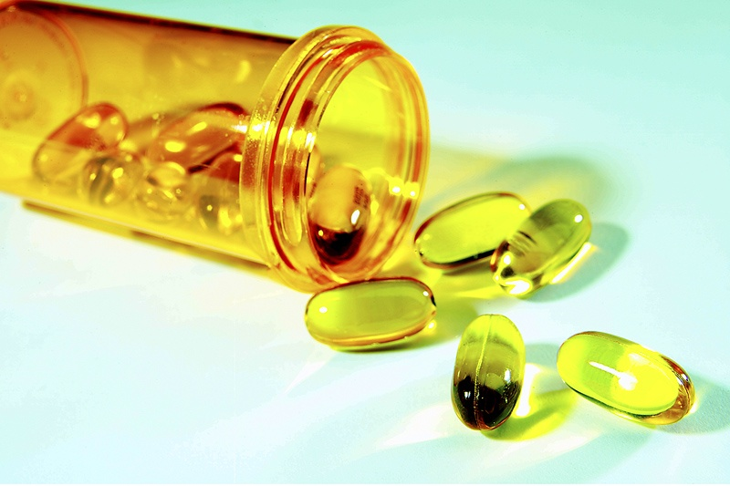
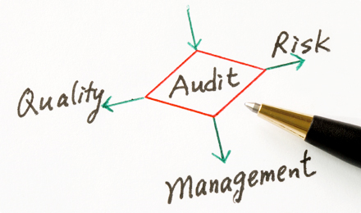
1-13 Being an Ulema is not sufficient to be a Halal auditor in this era of advanced technology processes.
Ulema of HCB should learn from Muslim scientists and investigate emerging technologies and methods being used in the Halal industry so that they can deliver the correct religious edict (fatwa).

Slide 27
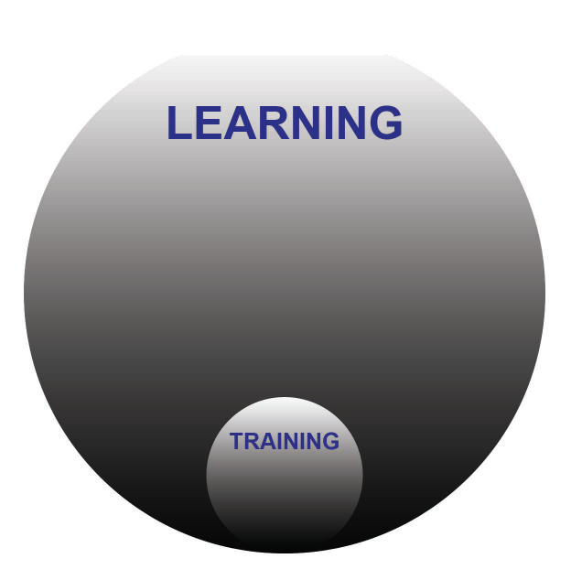
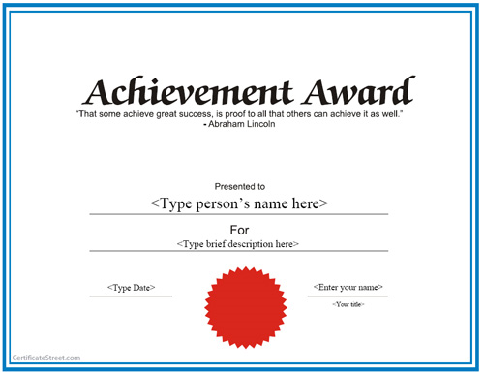
1-14 Many HCB do not certify theır personnel within the scope of their Halal works.
Halal
Professional
Certificate
Halal certifications with integrity is very important.
Halal experience leading to a professional Halal certificate is an added value.

Slide 28
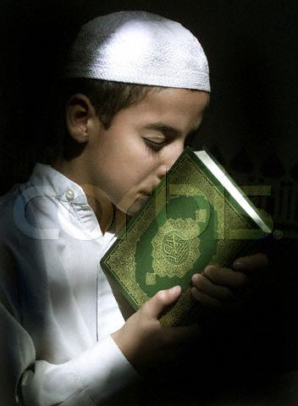
1-15 HCB are not being sincere in selecting their Halal slaughter operators who are honest in their belief.
Halal Muslim slaughter men some times deliberately do not perform their regular 5 times prayers, or at the time of slaughter do not utter the Tasmiyah.

Slide 29
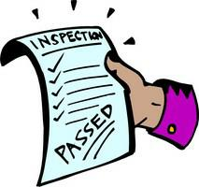
1-16 HCB do not inspect working premises.
Example:
Halal
Certified
Premises
Surveillance of Halal premises is often neglected.
HCB think that they could rely on industries they certified, so they only inspect one or two times a year. Inspections must be done routinely daily or weekly.
Inspection should go beyond raw materials. It should include equipments that are dedicated to Halal processing.

Slide 30
1-17 HCB lack of Islamic and scientific knowledge to differentiate between Halal from Haram.
Example:
Many newly introduced raw materials like food additives from wool or insects need a chemist who has the ability to explain the nature of the raw material to support Ifta commıttee’s decesıon.

Slide 31
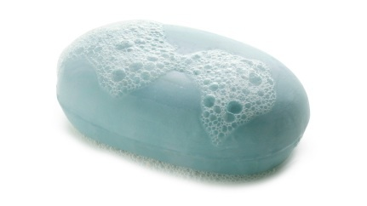
E.g. Istihala: Fat in Soap thoughts to be transformed
Glycerin in soap can revert back to glycerin.
i.e. the chemical reaction is reversible, the Najis original nature of raw material still exist, and thus the Istihala concept of Najis glycerin in soap as proposed by sharieah scholars was not correct*.
* According to my understanding of Istihala.

Slide 32
1-18 wıth few exceptions, there has been an effort to deteriorate the credibility of the HCB.
The interest of all HCB is to be accredited by Halal organizations like MUI of Indonesia so that their certificates are not rejected.
To be Halal accredited, such organization mainly interested in receiving high fees from HCB and this has affected the credibility of the accredited HCB as some time they are forced to bribe the Halal accreditor organization to be in the market.

Slide 33
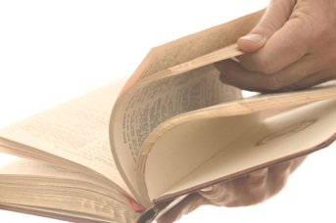
2
Not following Halal procedures
2-1 Some HCB may have a procedure manual or at least agree to follow a set of Halal process or standard but ın practıce they often don't follow them.
In another word their standards are ink on papers and in practice they are not being applied.
For example, complete Halal chain inspections and regular Halal monitoring are not done.

Slide 34
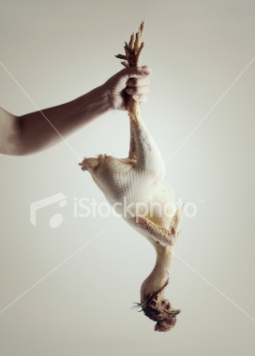
2-2 Most HCB that certify meat from stunned birds/animals as Halal do not check if the birds/animals at the time of slaughter were alive, and this is even impossible with the fast slaughtering operation such as birds.

Slide 35
HCB who accept stunning, they say: their slaughter men can detect dead chickens!!
But in an industrial context, when you mechanically slaughter more than 5000 chickens/hour it is impossible for a slaughter man to be alert and watchful all the time.

Slide 36
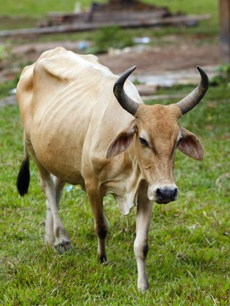
2-3 Although it is Halal, some HCB accept certifying meats from very weak animals. This is not Tayeb (poor meat quality).
This is noticed by active Halal groups in France.

Slide 37
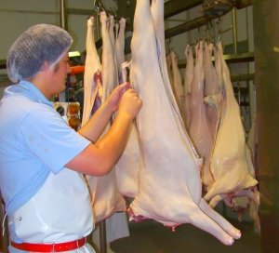
2-4 Many HCB approved meat as Halal without actual on-site Halal audit/supervision of the meat.
Halal audit/supervision: is a procedure whereby a Halal meat/carcasses are checked if they are complied with the Halal requirements.

Slide 38
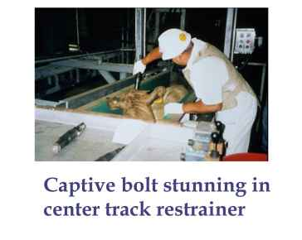
2-5 Many HCB approved meat as Halal from birds /animals that were inhumanely handled by the worker.
E.g. the use of captive bolt for stunning, is not an animal welfare.

Slide 39
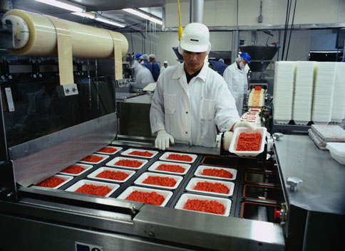
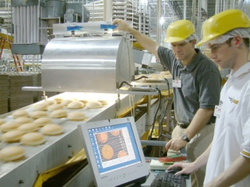
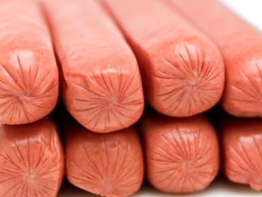
2-6 Some HCB certify processed meat as Halal that is manufactured by equipment normally used for Haram / or non-Halal processed meat.
Lately in GCC a non Halal casing were used for Halal hot dog made from chicken meat .

Slide 40
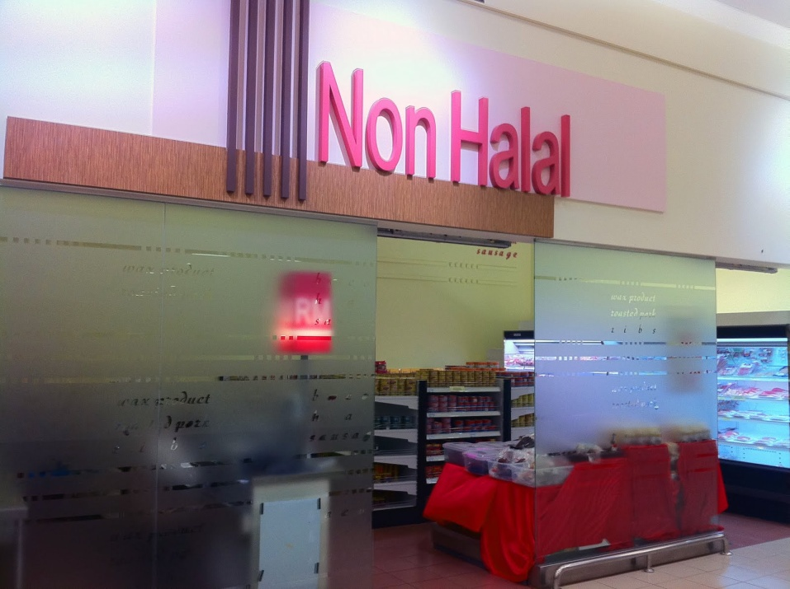
2-7 Most HCB are submitting to non-Halal laws.
Work on Haram productions lines
Accept non-approved slaughtermen
Accept Haram ingredients
Accept Istihala as an excuse to approve Halal
Accept mechanical slaughtering
Accept stunning

Slide 41
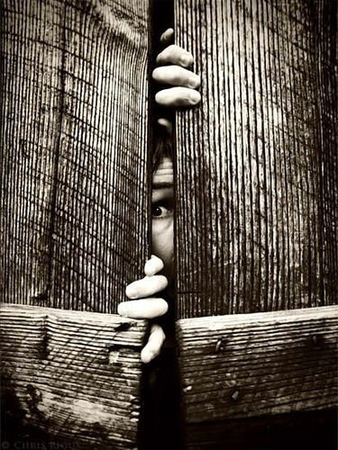
3
Lack of transparency
3-1 Many HCB do not disclose their standards, methods and their organization details.

Slide 42
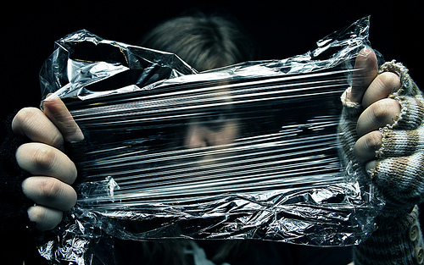
3-2 Many HCB do not provide complete and clear sufficient information to consumers for them to have better choices
i.e. they give misleading Halal certificates. Example………>

Slide 43
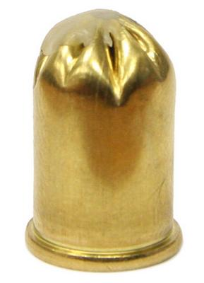
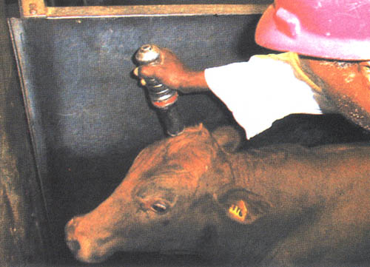
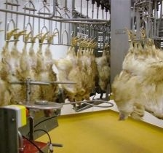
Example:
Some HCB certify stunned birds/animals as Halal and they put on their advertisements the following statement:

Slide 44
Hand Slaughtered
This statement is misleading as it imply that the meat is: Purely Halal with no stunning.

Slide 45
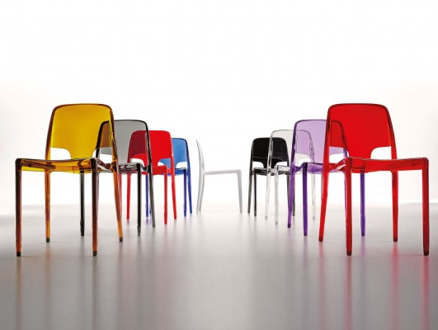
3-3 Some HCB are: 1) part of a manufacturing company or
2) a Muslim society established by a manufacturing company for the purpose of certifying their own services or products as Halal.

Slide 46
3-4 Transparency is a double edged sword.
Most HCB keep the things to themselves lest خشية أن they be criticized by another competing HCB.
Muslim governments can play a role in forcing transparency among HCB.

Slide 47
4
Lack of Islamic behaviors
4-1 Some HCB are not trustworthy.
i.e. some HCB give concessions تنازلاتof Halal requirements for the sake of gaining acceptance from processing plants/slaughter/ laboratories.

Slide 48
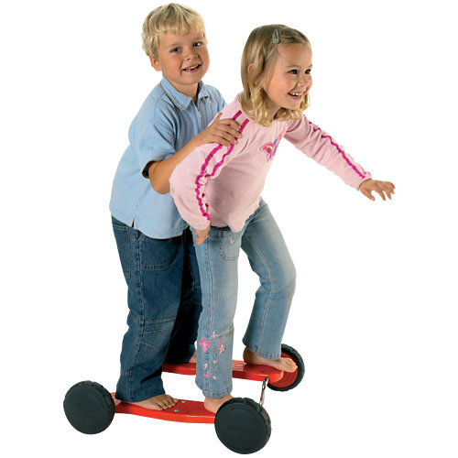
4-2 The absence of any kind of coordination between HCB occur as a result of considerıng other HCB as enemies.

Slide 49
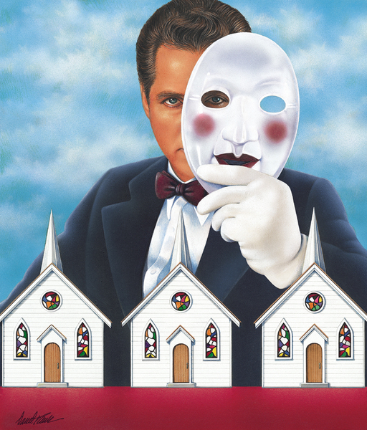
4-3 Some HCB that works closely to governmental agencies such as in EU instead of defending Halal they get paid for being silent when deceiving Muslim consumers.

Slide 50
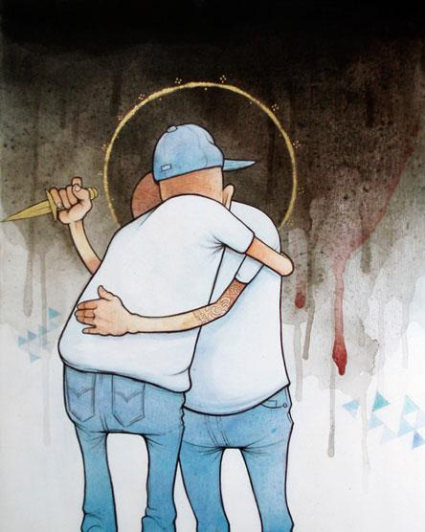
4-4 Definitely, there is lack of Islamic behavior among some HCB such as back-stabbing.

Slide 51
4-5 We still find lack of Islamic behaviors ın HCB especially among 1) Muslims of different ethnics origins or
2) among the newcomers into Halal industry, or
3) among Halal profit organizations.

Slide 52
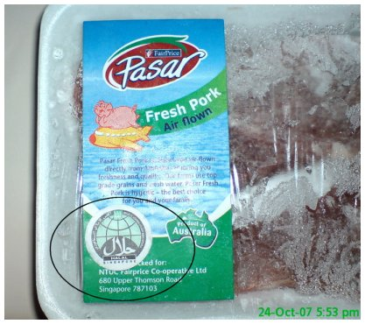
e.g. Fake and doctored مزيفة information claımed agaınst some HCB that they are certifying Haram meat!
This act is often seen on the internet to damage the image of some trustworthy HCB.

Slide 53
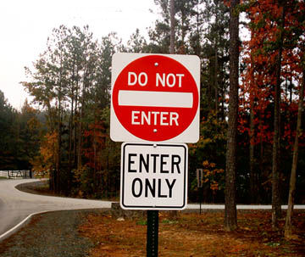
4-6 Contradictions in the private life of the people who provide Halal services.
They do not practice what they preach.
People who works for Halal do not implement Halal in their own private life, just visit their houses and you know what I mean: some do not care what bread or shampoo he buy for his family.
Many have no control on what they eat in conferences, i.e. they do not avoid eatıng Haram/Mashbooh meat or sweets.

Slide 54
5
Lack of commitment to Halal management system from the owner of HACB.
5-1 Most certifying bodies are a one-man show, even when associated with a center or a mosque.

Slide 55
5-2 Some HCB are non-Muslims.
You can find HCB of:
Qadiani, or
Jewish faith.
Some Ahlulkitab slaughter men who are non-believers.
Some slaughtermen are of Batini باطني faith.
Slaughter men who do not perform their prayers.

Slide 56
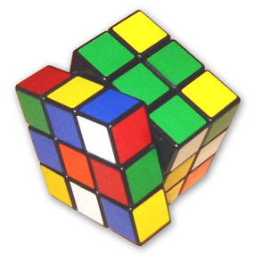
5-3 Many HCB have no interest in investing part of their income to solve Halal activities (slaughtering techniques and Istihala issues etc.,)

Slide 57
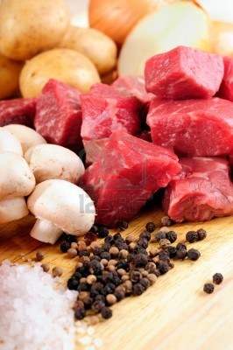
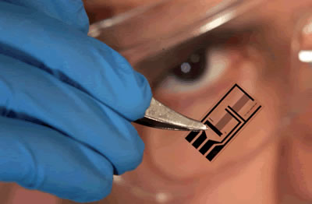
6
Lack of Halal raw materials supply.
6-1 Some HCB who certify processed food as Halal lack of Halal raw ingredients or Halal casing from genuine Halal supplier.
For this reason HCB cannot guarantee the integrity of their Halal supply chain.

Slide 58
7
Lack of Halal technical training.
7-1 Halal technical operator, supervisors, top managers are not getting a thorough training on what they need to know about Halal.

Slide 59
Conclusions
Halal certification bodies, HCB should be accredited based on internationally approved Halal standard coupled with periodical audit by an approved international accredit Muslim body like GAC-GSO (Gulf Accreditation Center-Gulf Standard Organization).
HCB should collaborate with other approved HCB to serve Halal rather than serving individual interests.
Mutual recognition of Halal accredited HCB will boost Halal worldwide.

Slide 60
Recommendations
There must be an international trustworthy Muslim organization that takes the task of harmonizing Halal standards, Halal services, and licensing Halal certification bodies globally.
This international trustworthy Muslim organization could be GSO (Gulf Standard Organization) or IIFA (Islamic International Fiqh Academy).

Slide 61
The following information was gathered from:
Mr. Darhim Dali Hashim (Malaysia)
Mrs. Mariam Abdul Latif (Malaysia)
Dr. Muhammad Munir Chaudry (USA)
Mrs. Hanen Rezgui Pizette (France)
Dr. Anwar Ghani (New Zealand)
Mr. Fethallah Othmani (France)
Dr. Hani Mansour Al-Mazeedi (Kuwait)

Slide 62
References
Nordin, N., Md Noor, N.L., Hashim, M., and Samicho, Z. 2009. Value Chain Of Halal Certification System: A Case Of The Malaysia Halal Industry. European and Mediterranean Conference on Information Systems 2009 (EMCIS2009). Crowne Plaza Hotel, Izmir.
ASIDCOM Association of Awareness, Information and Defense of Muslim Consumers, France. http://www.asidcom.org/Report-The-Muslim-Consumer-as-the.html
Stitou, N. and Rezqui, H. 2012. The Muslim Consumer as the Key Player in Halal. ASIDCOM investigations 2010-2012.
http://www.asidcom.org/IMG/pdf/ASIDCOM_Report-french_muslim_consumers.pdf
Hashim, D.D. 2011. Introduction to the Global Halal Industry and its Services. In Halal Industry and its Services Conference. State of Kuwait, Salmiyah.
GSO, Kuwait, 2008. Halal Food, Part (2): The Requirements for Accreditation of Issuing the HALAL Food Certification Centers.
د. محمد نافع سليمان السبع، عضو في لجنة الحلال في مؤسسة الوقف الاسكندينافي.
http://www.akhbar.dk/ar/article2/2374-2011-09-20-09-55-08.html

Slide 63
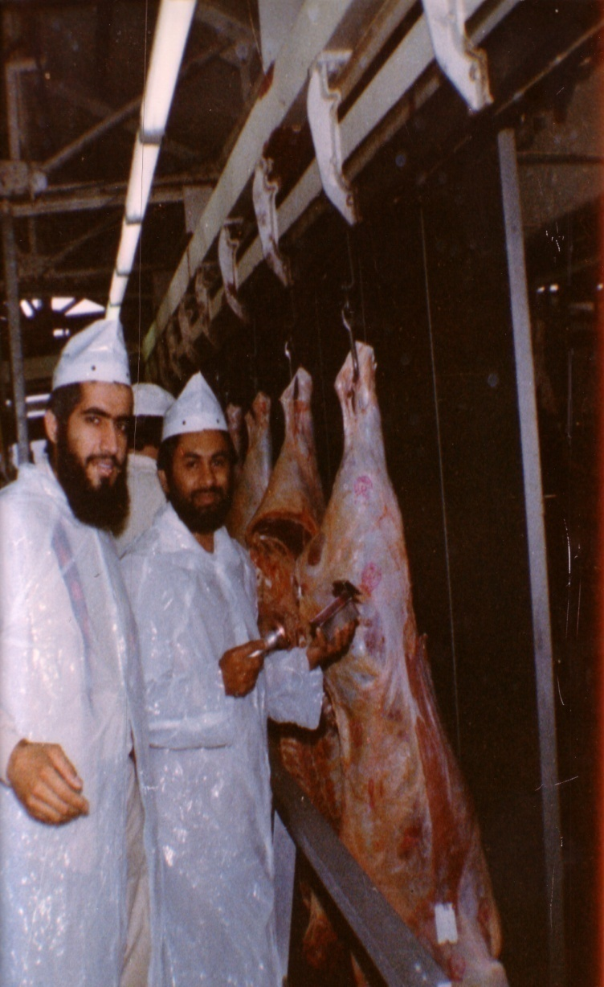
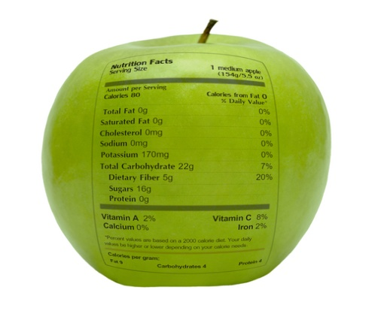
شكراً لاستماعكم
سبحنك اللهم وبحمدك أشهد أن لا إله إلا أنت، أستغفرك وأتوب إليك
د. هاني منصور المزيدي
مع الأخ أمجد محبوب في أستراليا سنة 1981
Dr. Hani Mansour Al-Mazeedi
With brother Amjad Mahboob in Australia in 1981

Slide 64
www.HalalEA.com
Trademarks, icons, images belong to their respective owners.
© Halal Sciences Academy Limited

